Slide 1

From: NYC
To: ?

Slide 2
Methodology
Deployed Selenium to scrape TripAdvisor (dynamic site)
Eight total features extracted
Departure date
Price
Airline
Starting airport
Ending airport
Start and end time
Duration
Fly score
Added day of the week and month once data frame was created
Constraint: flight deals unavailable past 12/21/2020

Slide 3
Overview
Questions
How do prices fluctuate over a given year?
Is Tuesday really the best day of the week to book a flight?
What does the data say about the three NYC airports?
Findings
Discussion
Conclusions

Slide 4
Price fluctuation over a year?

Slide 5
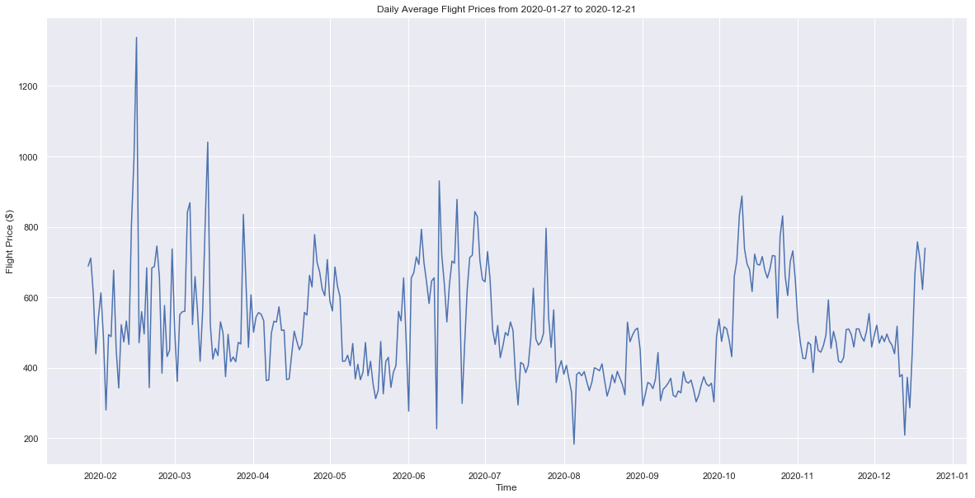

Slide 6
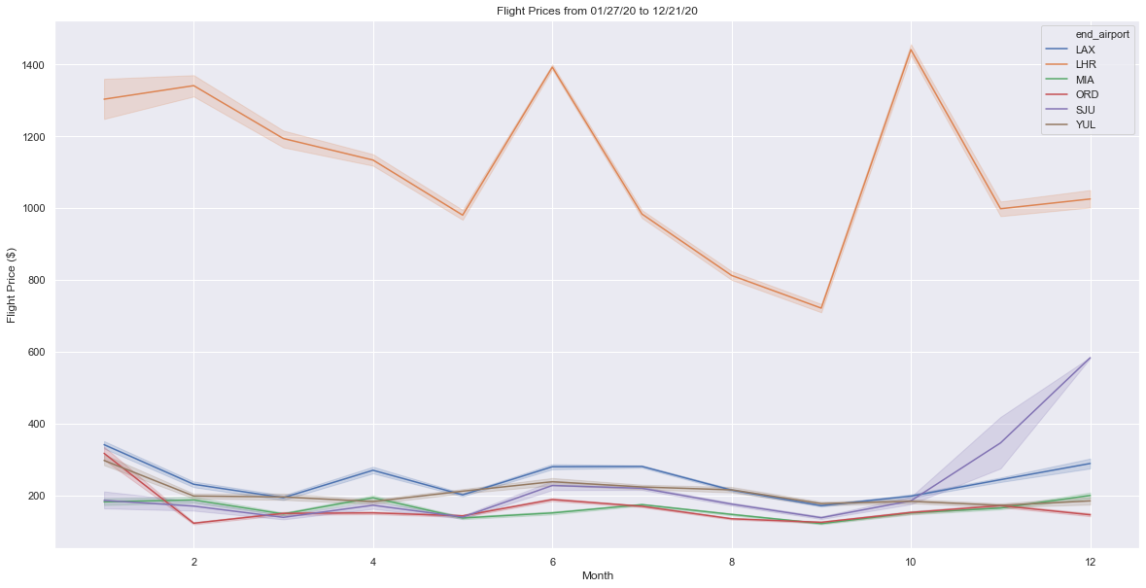

Slide 7
2. Best day of the week to buy?

Slide 8
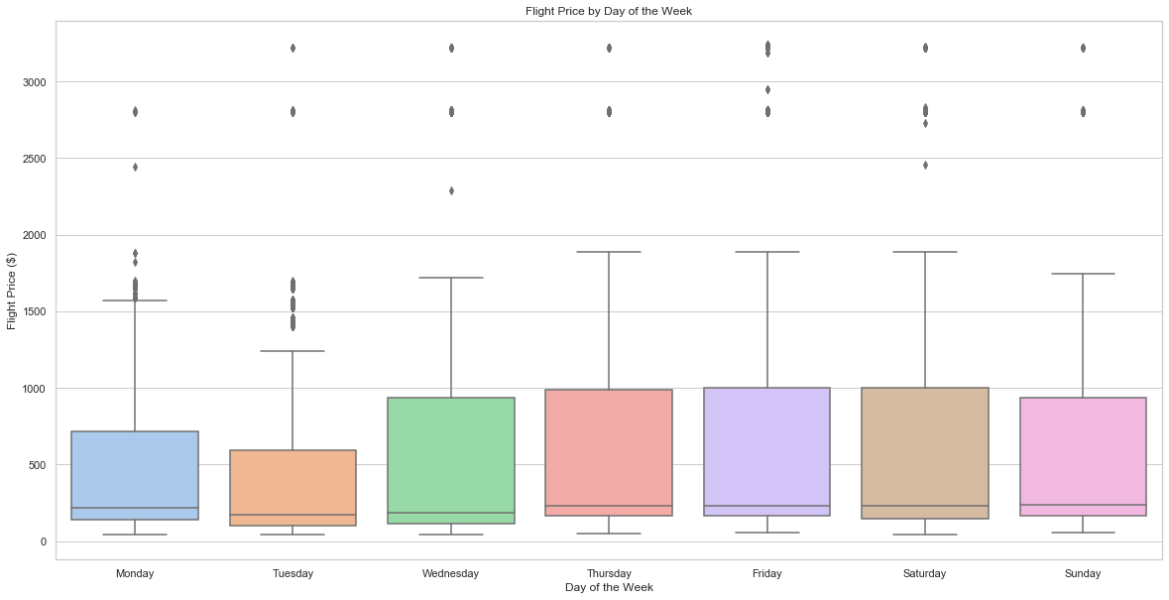

Slide 9
3. How do NYC airports stack up?

Slide 10
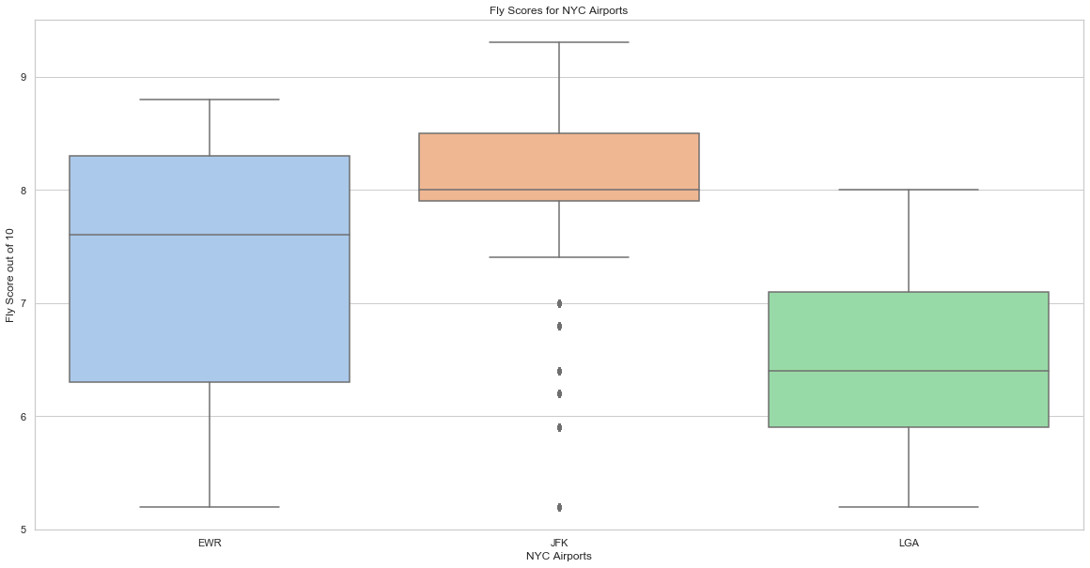

Slide 11
Further Analysis

Slide 12
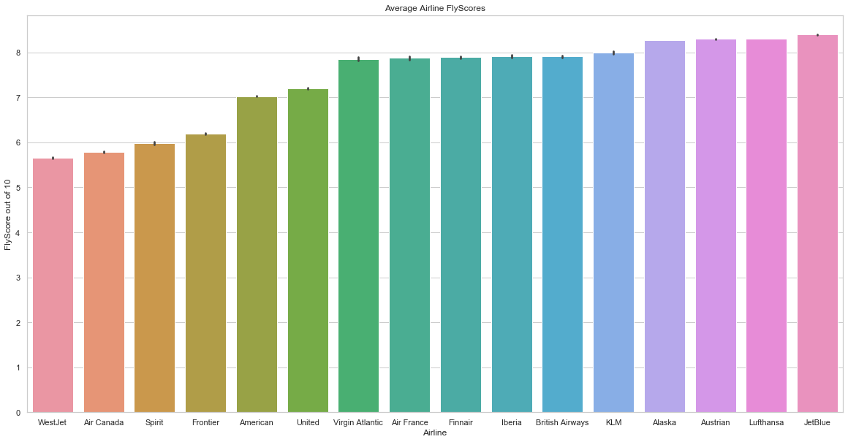

Slide 13
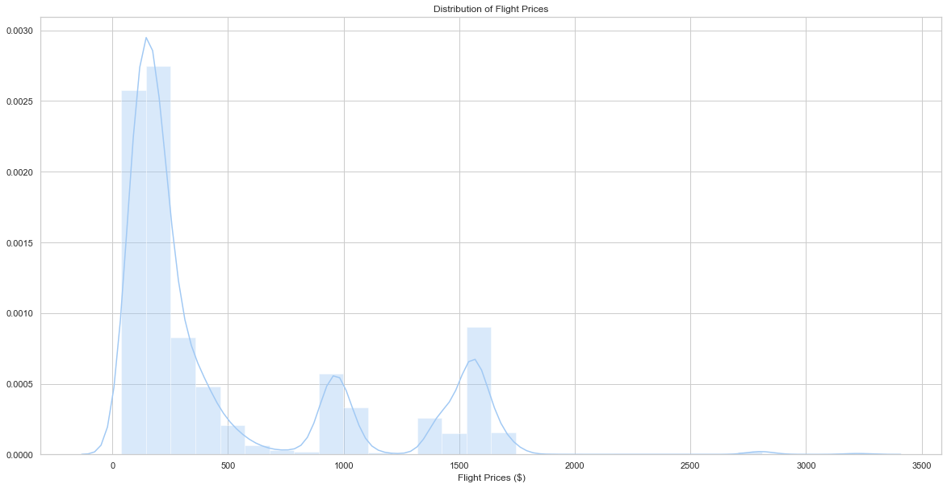

Slide 14
Conclusions
Flights are most expensive during the middle of each season
Best day of the week to buy flights IS Tuesday
JFK has the best flights based on median Fly Score
Distribution of flight prices

